Slide 1
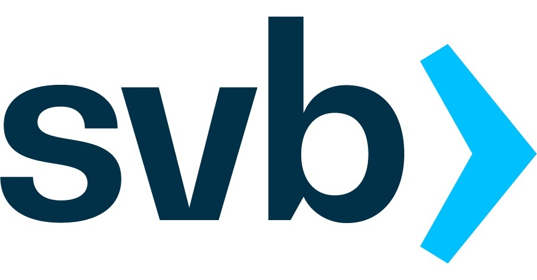


Investigating Silicon Valley Bank Crash and AI in predicting Market Risk and Crash
Name | Matriculation Number
Lim Qing Rui | U2010816G
Amanda Ling Zhi Qi | U2022213G
Huang Jingyi | U2011981E
Adeline Soh Ziyi | U2110084J
Tay Wen Wei | U2110742C
Deionna Chee Rui Ping | U2021449D

Slide 2
Table of Contents
SVB Crash and Analysis
Artificial Intelligence in Markets
01
SVB Overview
02
Issues in SVB
01
AI in Financial Sector
02
AI in Risk Management
03
Liquidity and Data Analysis
04
Alternative Scenarios
03
AI Chatbots
04
Fraud and AI
06
Lessons Learnt
05
AI Ethical Considerations
05
SVB Ethical Considerations

Slide 3
SVB Crash and Analysis
01
SVB Overview
02
Issues in SVB
03
Liquidity and Data Analysis
04
Alternative Scenarios
06
Lessons Learnt
05
SVB Ethical Considerations

Slide 4
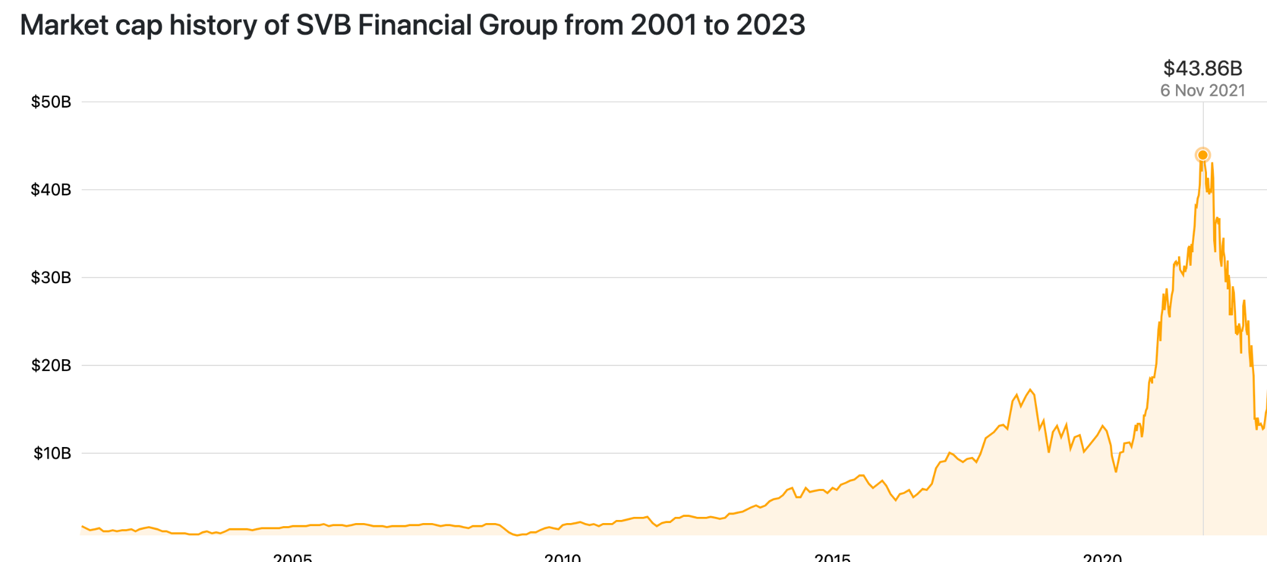
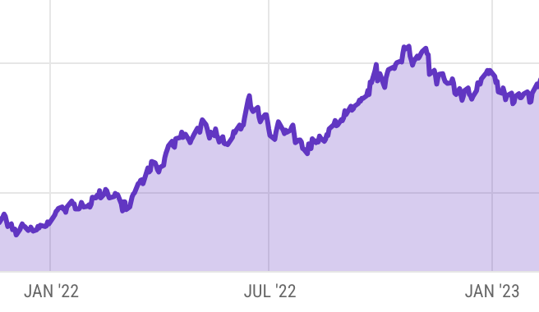
SVB overview
SVB 2021-2023
Peak market capitalisation of 43.8 Billion as of Nov 2021
Banking nearly 50% of US venture backed firms
Huge influx of deposits from venture capital companies and high net worth clients leading
Invested heavily into long term treasury to capitalise on the sharp rise in deposits
Portfolio consist of close to 50% Held-To-Maturity (HTM) Treasuries
Interest rate & HTM treasury yield rose → fall in HTM prices
Steep decline of 20% → cumulative USD$ 15 Billion in unrealised losses
4.25
Fear of low liquidity → Panic withdrawal from investors → USD$1.8 billion dollar loss
Vicious cycle of increased fund withdrawal not met due to lack of adequate cash supply
1.52
SVB Overview
Issues in SVB
Liquidity and Data Analysis
Alternative Scenarios
SVB Ethical Considerations
Lessons Learnt
AI in Financial Sector
AI in Risk Management
AI Chatbot
Fraud and AI
AI Ethical Considerations

Slide 5
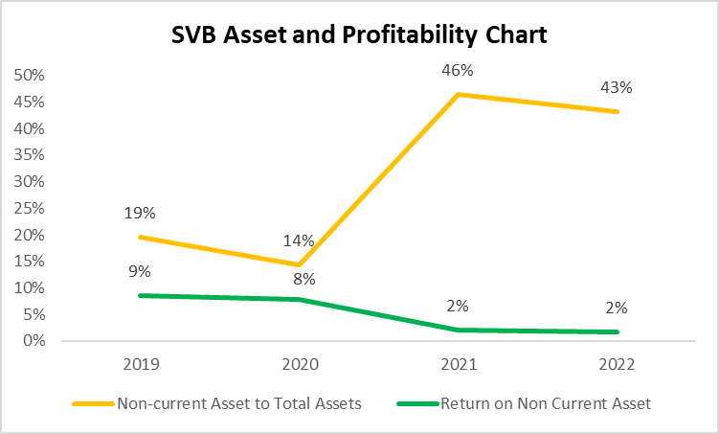
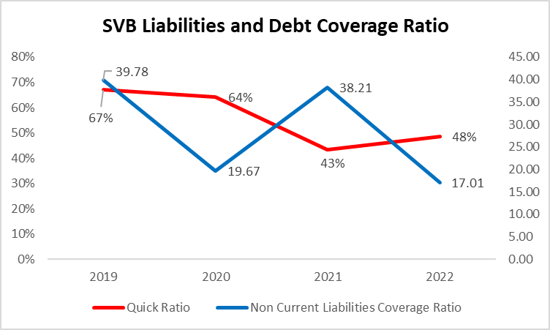
Issues leading up to the crash
Rapid rise in deposits
Hot money from low interest rate during Covid
Substantial deposits from U.S. companies like Circle and BlockFI.
Clients with exclusive agreements like DocuSign and Upstart restricted to depositing funds only with SVB
Aggressive interest hike
Overexposure of Securities
Fed raised rates from 0.25% to 5.00% to counter inflation
Weighted average duration of HTM, average time required for SVB to receive all bond cash flows increased notably by 2.1 years, rising over 50% from 2021 to 2022
Market interest rates increase, prices of fixed-rate bonds tend to decrease
Indicating increased risk escalation
Overemphasis on Held to Maturity (HTM) securities in the investment portfolio, reached 42% of total asset portfolios, 78% of total securities
Lack of risk mitigation strategies, such as hedging and portfolio diversification or short-term securities to hedge against long-term holdings led to the inability to meet short-term withdrawals.
Only 18.8% of total assets are cash/cash equivalents and Available for Sale (AFS) securities
SVB Overview
Issues in SVB
Liquidity and Data Analysis
Alternative Scenarios
SVB Ethical Considerations
Lessons Learnt
AI in Financial Sector
AI in Risk Management
AI Chatbot
Fraud and AI
AI Ethical Considerations

Slide 6
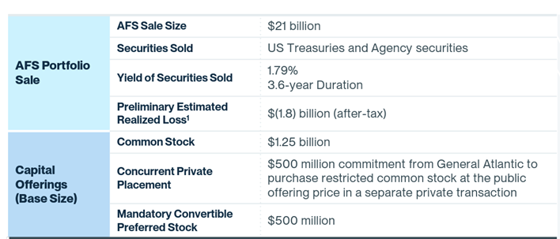
What happened during the crash?
High Leverage Ratios
USD$91 bn of debt holdings (50% of balance sheet)
94% of deposits not insured by FDIC
Debt to Asset ratio: 13.6X
Risk-based capital: 16.18%
Deposits exceed FDIC USD$250,000 threshold
2X higher risk-based capital threshold for banks showing illiquidity and higher asset risk
Higher capital adequacy ratio of 15.4% masked initial illiquidity
Increasing interest rate environment
SVB sold USD$21 billion bonds
SVB’s equity issue to raise funds
Liquidity crunch within SVB
Decrease in cash inflow and increased withdrawals
Impacted bank’s lending ability and net interest income as cost of capital increase.
SVB experienced higher financial and operating leverage
Inability to meet current customer withdrawals and needed to realise $1.8 billion in losses from bonds to pay creditors and debtors. Preliminary sign of default
Pivoted to equity issue to raise capital to cover treasury loss.
Equity issue decreased EPS from $28.27 to $24.90.
Investors saw 14% decrease as lower profitability and started sell-off
Inability to meet withdrawals as only 18.8% of internal assets were liquid assets (Cash, Short term assets).
Treasury portfolio continued to face decrease in 20% valuation and lower liquidity
Situation become challenging for SVB to obtain more customer deposits as customers are usually venture-back businesses and downturn in IPOs and venture capital occurs. Businesses continued withdrawing SVB deposits to repurpose money
SVB Overview
Issues in SVB
Liquidity and Data Analysis
Alternative Scenarios
SVB Ethical Considerations
Lessons Learnt
AI in Financial Sector
AI in Risk Management
AI Chatbot
Fraud and AI
AI Ethical Considerations

Slide 7
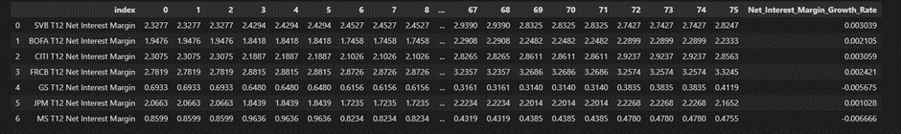
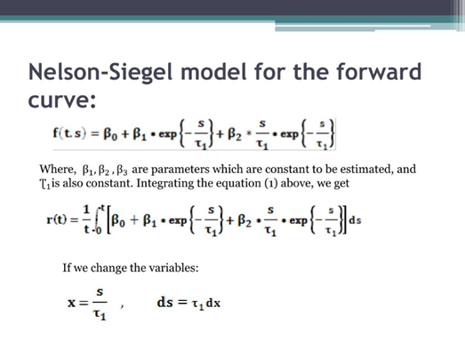
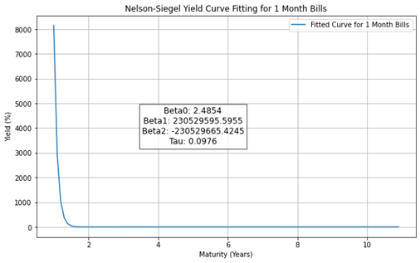
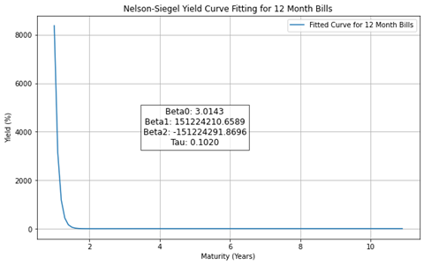
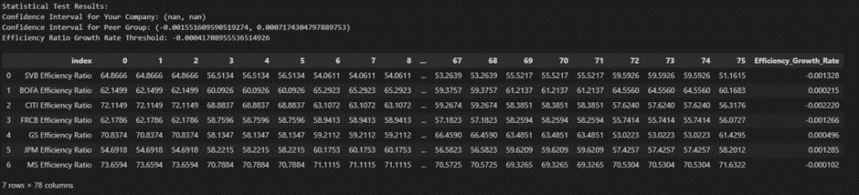
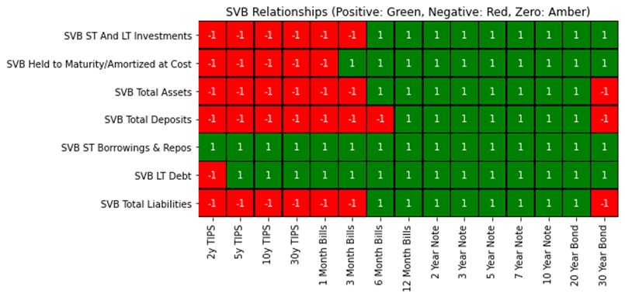
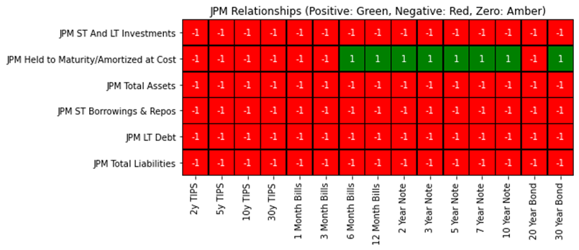
Data analysis and Quantitative models
Student’s T-test for Efficiency Ratio, Net Interest Margin
Optimizing SVB’s assets using Yield Curve model
T12 Net Interest margin for SVB at a 95% Confidence Interval showed that net interest margin from operating activities such as Loaning out cash to borrowers was at a healthy margin for SVB. However, the T12 Net interest margin is not the best as it is the 4th highest amongst all other peer banks. Despite this, markets react more heavily to negative news as shown in lower efficiency ratios and lower assets returns. The interest margin growth was not adequate enough to offset the decrease in efficiency ratio over the periods observed.
Nelson-Siegel model shows high yields for long term assets (7, 10, 30 year yields), indicating high risk of default and lower valuations in short term
Portfolio rebalance can be done using 3 and 12 months bills which offer higher yields (with similar Beta0/expected yields) compared to SVB’s holdings and provide higher liquidity, improving bank risk and stronger balance sheet
Linear Regression of SVB’s Assets and Yields
SVB’s Efficiency Ratio performed the worst in terms of all banks and was underutilizing assets. Banks with lower efficiency ratios have a lower return on investment, and can be seen as a precursor to bank run. Despite a 95% confidence interval, SVB’s efficiency growth ratio of -0.001328 was close to the lower limit of -0.00155160. Banks that have extremely low values close to their lower confidence limits are more likely to fail the t-statistics of being efficient and hence more likely to result in bank failures. (2-tailed hypothesis test)
SVB assets had multiple positive relationships (Left graph) to interest rates, signalling higher sensitivity to market conditions. Direct positive relationship between HTM securities and assets shows lack of diversification. High correlation present between SVB’s asset returns and Treasury yield, showing high sensitivity and experience in market value decline when yields rise. Other banks (JPM ) had proper diversification and lower correlation (Right graph)
SVB Overview
Issues in SVB
Liquidity and Data Analysis
Alternative Scenarios
SVB Ethical Considerations
Lessons Learnt
AI in Financial Sector
AI in Risk Management
AI Chatbot
Fraud and AI
AI Ethical Considerations

Slide 8
Impacts of SVB Collapse and Alternative Scenarios
Broader impact of collapse to Financial Institutions
Federal Reserve Meeting after Collapse
Downfall of SVB had significant repercussions for the banking sector and broader financial institutions
It triggered panic, with weekly consecutive bank collapses dominating headlines
Crisis similar to 2008 financial crisis and eroded depositor confidence in small to medium-sized American banks' risk management capabilities
Signature Bank, hit hard by the crisis, experienced a massive $20 billion withdrawal on March 10, just days after SVB's collapse, and closed its doors on March 12
Clients moved deposits to larger institutions like JPMorgan Chase and Citi, perceived as safer havens. These large banks quickly adapted to accommodate the influx of new clients as smaller banks closed
Increase legal scrutiny and implement credit testing aspects of SVB’s collapse which will impact other banks. Independent regulator and auditor appointment to scrutinize banks and their holdings.
Mitigating the collapse of SVB
Depositor Asset Diversification:
Depositors can diversify their holdings across multiple banks
Reduces the need for banks to rely heavily on these assets for revenue
Increases depositors' chances of recovering a higher portion of their assets in the event of a bank default, as exemplified by the defaults of SVB and Signature Bank
Liquidity and cash management planning:
Liquidity analysis and planning for operational efficiency, maintain optimal operating leverages and financial leverages
Strategic initiatives by SVB could include securing these deposits with other banks and conducting Financial Planning in accordance with scenarios
SVB can also increase the cash to ensure that sufficient cash is available to meet depositors/creditors' needs, contingencies and large-sum withdrawals.
Asset Diversification at SVB:
SVB should allocate less than 20% of its assets to a single investment category (reduce market risk exposure and asset portfolio volatility)
Diversification across assets classes lower market exposure, enhance liquidity, improves efficient frontier curve in asset management
SVB could use short-term treasuries to match interest rates and yields, mitigating overleverage, instead of heavily relying on 10-year treasuries
Risk management department and oversight:
SVB did not allocate key personnel leading up to their solvency crisis
Key personnel (Risk managers) could have been appointed to identify, monitor, hedge and spot risks before critical leverages occur
Risk managers would be able to identify shortcomings through credit stress tests and quantitative frameworks development to generate default scenarios using tools (E.g. Monte Carlo simulations or Risk-Weighted Assets models)
SVB Overview
Issues in SVB
Liquidity and Data Analysis
Alternative Scenarios
SVB Ethical Considerations
Lessons Learnt
AI in Financial Sector
AI in Risk Management
AI Chatbot
Fraud and AI
AI Ethical Considerations

Slide 9
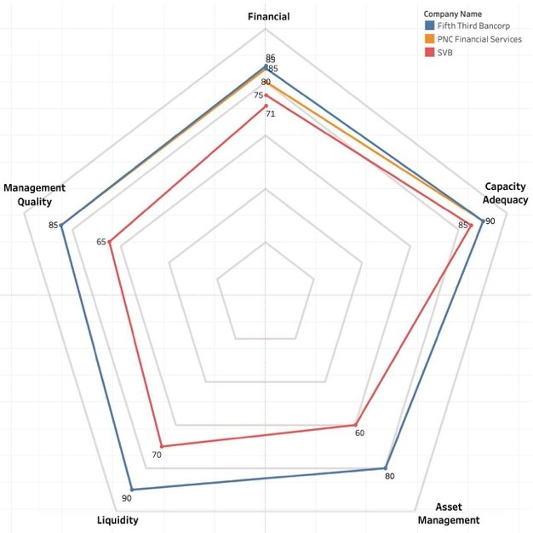
SVB Ethical Considerations
Overview of SVB Collapse
Regulator Oversight
High Risk Exposure
High Leverage, with a debt-to-equity ratio consistently above 10.
Weak Risk Management
Post-Collapse Regulations
Clawback Uncertainty
Social Media Impact
Regulatory Intervention
Radar Chart Analysis
Current regulations lack comprehensive benchmarking among banks, hindering understanding of compliance standards.
We can perform a horizontal analysis, comparing SVB with peers for a comprehensive outlook
SVB Overview
Issues in SVB
Liquidity and Data Analysis
Alternative Scenarios
SVB Ethical Considerations
Lessons Learnt
AI in Financial Sector
AI in Risk Management
AI Chatbot
Fraud and AI
AI Ethical Considerations

Slide 10
SVB Ethical Considerations
GREED
Greed and Excessive Risk
Ethical Concerns and Insider Trading
Greed is a powerful motivator influencing individuals to take unprecedented risks.
SVB’s management, driven by a desire for large profits, took on excessive risk in the pursuit of maximizing earnings.
Detrimental effects of greed include financial crises, declining investor confidence, and liquidity issues in the bank.
Following SVB’s collapse, CEO Greg Becker and CFO Daniel Beck sold their SVB stocks days before the public release of the Q1 SVB report -> Suggests the executives had non-disclosed information about the bank’s financial situation.
Insider trading involves trading securities using material, nonpublic information -> Divestment before a public report raises suspicions of insider trading, an unethical practice undermining market fairness and equal access to information.
Revelation triggers ethical and legal inquiries into the actions of those in authority -> These actions suggest personal gains at the expense of others, emphasizing ethical considerations and potential legal violations.
Addressing Greed through Regulation
Strengthening the regulatory environment, improving corporate governance, promoting transparency and accountability can help.
Educating the public and investors about risks associated with greed is crucial.
SVB Overview
Issues in SVB
Liquidity and Data Analysis
Alternative Scenarios
SVB Ethical Considerations
Lessons Learnt
AI in Financial Sector
AI in Risk Management
AI Chatbot
Fraud and AI
AI Ethical Considerations

Slide 11
Lessons Learnt
Main Cause of SVB’S Failure
Lessons Learned and Regulatory Implications
Subpar risk management procedures
Making significant bets on Treasury bonds at a period of low interest rates
“Investment securities accounted for 55% of assets, double the U.S. bank average (Eisen B, et al, 2023).”
“As interest rates climbed in 2022, bond portfolios suffered, leading to losses.”
Financial institutions can learn to have robust risk management practice in place (Rossi, 2023)
Indicates the need for more regulatory control particularly for banks operating in high-risk industries or challenging markets.
Conduct more routine stress testing and evaluation of risk management procedures.
Increase the agility of supervision
SVB Overview
Issues in SVB
Liquidity and Data Analysis
Alternative Scenarios
SVB Ethical Considerations
Lessons Learnt
AI in Financial Sector
AI in Risk Management
AI Chatbot
Fraud and AI
AI Ethical Considerations

Slide 12
Artificial Intelligence in Markets
01
AI in Financial Sector
02
AI in Risk Management
03
AI Chatbots
04
Fraud and AI
05
AI Ethical Considerations

Slide 13

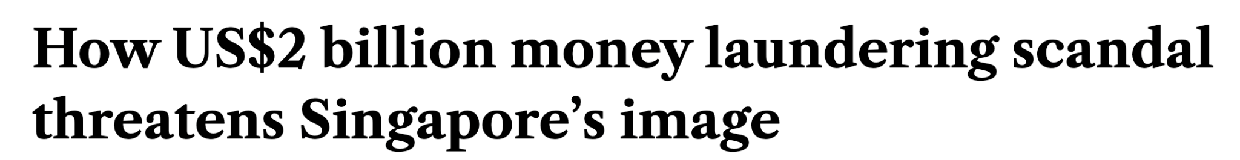

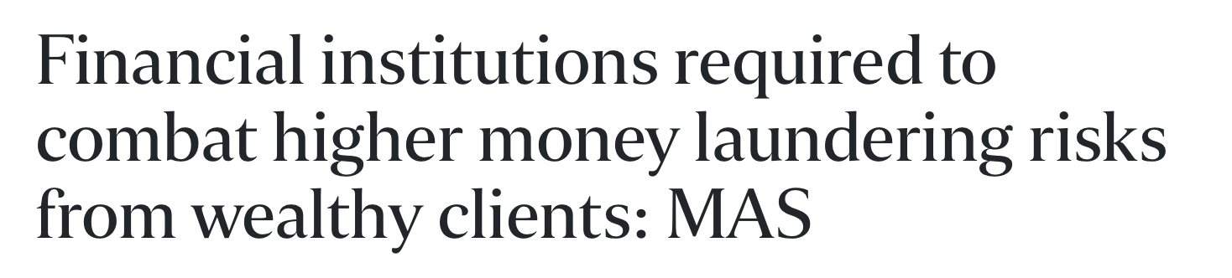
Current Issues
Problem Statement
How can advancements in computer and smart technologies be harnessed to effectively mitigate and reduce instances of anti-money laundering, and used in Financial Sector to ensure a more secure and transparent financial ecosystem?
SVB Overview
Issues in SVB
Liquidity and Data Analysis
Alternative Scenarios
SVB Ethical Considerations
Lessons Learnt
AI in Financial Sector
AI in Risk Management
AI Chatbot
Fraud and AI
AI Ethical Considerations

Slide 14
General Functions of AI
Basic Functions of AI
Analyse market conditions, trends & economic indicators to forecast financial crises
Advanced forecasting ability to analyze large datasets to aid in identification of threats and opportunities
Enhance decision-making and risk management as they identify early warning signs for financial crises
Example - Scenario Analysis
Utilize AI and ML to generate potential business scenarios, taking into account market conditions
and consumer behavior
Lead to more accurate and reliable forecasts of realistic simulations
E.g. Gain valuable insights into future market dynamics by examining the market data, predicting interest rates and inflation, and forecasting changes in key variables
SVB Overview
Issues in SVB
Liquidity and Data Analysis
Alternative Scenarios
SVB Ethical Considerations
Lessons Learnt
AI in Financial Sector
AI in Risk Management
AI Chatbot
Fraud and AI
AI Ethical Considerations

Slide 15
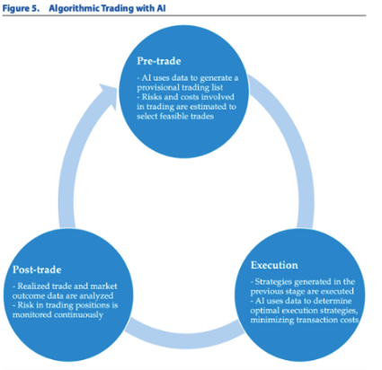
AI in Financial Crisis
Algorithmic Trading
Use algorithms to automate trading process
Make use of historical stock and market date to predict future return of assets
Real-time market tracking and decision making using Artificial Neural Network
Sentiment Analysis
Research conducted to see how sentiment analysis could assist in predicting market volatility
Focused on using news article headlines and social media posts to influence prediction of volatility
Result : Sentiment derived from headlines can be a predictive signal for market returns with an accuracy
rate of 65%
Result: Tweets has a strong negative correlation between positive sentiment and market volatility
SVB Overview
Issues in SVB
Liquidity and Data Analysis
Alternative Scenarios
SVB Ethical Considerations
Lessons Learnt
AI in Financial Sector
AI in Risk Management
AI Chatbot
Fraud and AI
AI Ethical Considerations

Slide 16
Current practices of AI & ML to deal with AML
Google Cloud AML
Identify money laundering and suspicious behaviour by evaluating sources like financial transactions,
client profiles, demographics and transaction patterns
Detect irregularities in transactions
Adopted by HSBC that led to 40% reduction in compliance check time while enhancing accuracy
of AML program
Predictive Modelling
Research on the different types of predictive modelling techniques
Data used was the IBM Synthetic Financial Data Money Laundering dataset
Concluded that Random Forest was the model with the highest accuracy rate
Note: Suggest Further analysis with more diverse dataset
SVB Overview
Issues in SVB
Liquidity and Data Analysis
Alternative Scenarios
SVB Ethical Considerations
Lessons Learnt
AI in Financial Sector
AI in Risk Management
AI Chatbot
Fraud and AI
AI Ethical Considerations

Slide 17
Using AI as a Risk Management Tool
Cyber Risk
Credit Risk
AI can be used to assess a company’s cyber risk and calculate the return on security investment (ROSI).
Early Warning Systems (EWS)
Identify non-performing assets to allow banks to take corrective actions early on.
By integrating data from different sources and using AI, the detection of early warning signs can be improved.
Credit Underwriting
Lenders assess borrowers'’ creditworthiness before issuing them a loan or credit facility.
AI-powered models can use clients’ financial data, market trends and economic activity trends to predict loan delinquencies.
Example - Safe Security
A cyber security company.
Safe ROSI Calculator
Calculates ROSI in real-time to ensure the highest return.
Constantly learns new information to adapt to market changes.
Example - Punjab National Bank
Example - Zest AI
Plans to upgrade its EWS by integrating AI to crawl the web for information on borrowers’ activities
Uses ML techniques to analyse data from various sources to make prediction on borrowers’ creditworthiness.
SVB Overview
Issues in SVB
Liquidity and Data Analysis
Alternative Scenarios
SVB Ethical Considerations
Lessons Learnt
AI in Financial Sector
AI in Risk Management
AI Chatbot
Fraud and AI
AI Ethical Considerations

Slide 18
Using AI as a Risk Management Tool
Fraud Risk
Market Risk
AI-powered algorithms can analyse real-time big data to detect fraudulent activities.
Such ML algorithms have the ability to learn and adapt to emerging fraud patterns.
30% Increase in fraud detection rate compared to traditional rule-based methods.
Market Risk Assessment
AI can be utilised in making investment decisions.
Monitoring Market Conditions
Sentiment analysis to analyse people’s attitude towards an event.
Help banks analyse the sentiment of the financial market, which is indicative of the market conditions.
Example - BlackRock
Use of AI and ML powered mathematical models to identify trends.
Use of smart beta portfolios (AI-powered): flexibility to utilise different strategies to allocate weights within an index.
Example - Danske Bank
Denmark’s largest bank
Deployed an AI-driven fraud detection platform
Analyses large numbers of latent features for millions of banking transactions to detect fraud in real time.
Example - HSBC
Uses NLP for market forecasting and exploring to gain real-time insights and understanding on the market sentiment.
SVB Overview
Issues in SVB
Liquidity and Data Analysis
Alternative Scenarios
SVB Ethical Considerations
Lessons Learnt
AI in Financial Sector
AI in Risk Management
AI Chatbot
Fraud and AI
AI Ethical Considerations

Slide 19
AI Chatbot
Functions
Benefits
Answer customers’ questions during financial crisis
Manage customers’ expectations
Restore customer confidence
Identify customers who are at risk of withdrawing their funds
Banks can focus their human resources on other more value-adding tasks, boosting productivity
Increase customer retention
Example - HSBC
AI Chatbot Amy
COVID-19 accelerated the demand for such technologies
Replies immediately, available online 24/7
SVB Overview
Issues in SVB
Liquidity and Data Analysis
Alternative Scenarios
SVB Ethical Considerations
Lessons Learnt
AI in Financial Sector
AI in Risk Management
AI Chatbot
AI Stress Testing
AI Ethical Considerations

Slide 20

AI Chatbot - Monitoring Market Condition
SVB Overview
Issues in SVB
Liquidity and Data Analysis
Alternative Scenarios
SVB Ethical Considerations
Lessons Learnt
AI in Financial Sector
AI in Risk Management
AI Chatbot
AI Stress Testing
AI Ethical Considerations

Slide 21
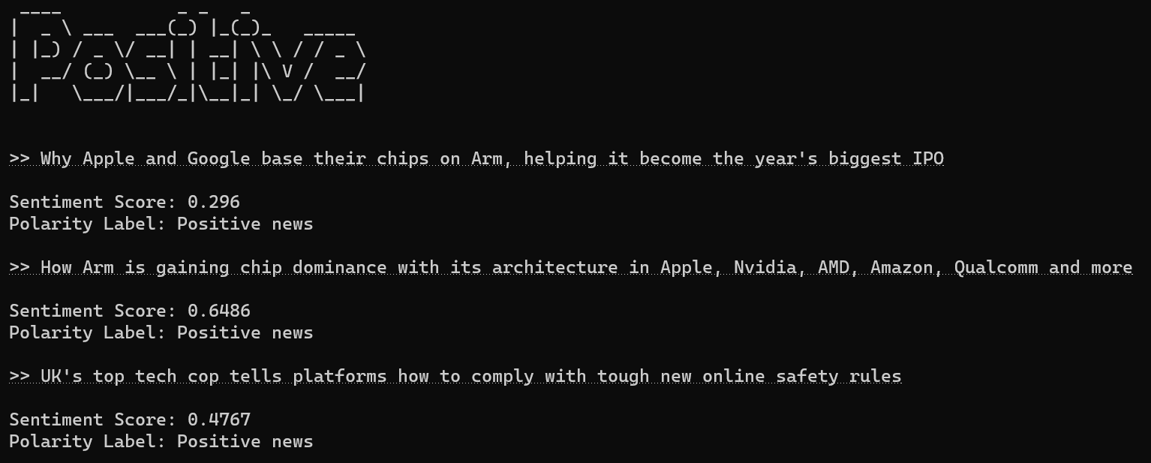
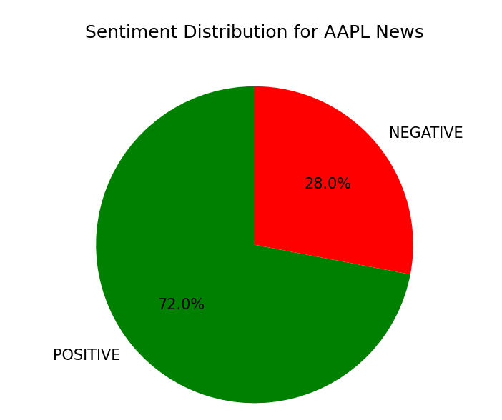
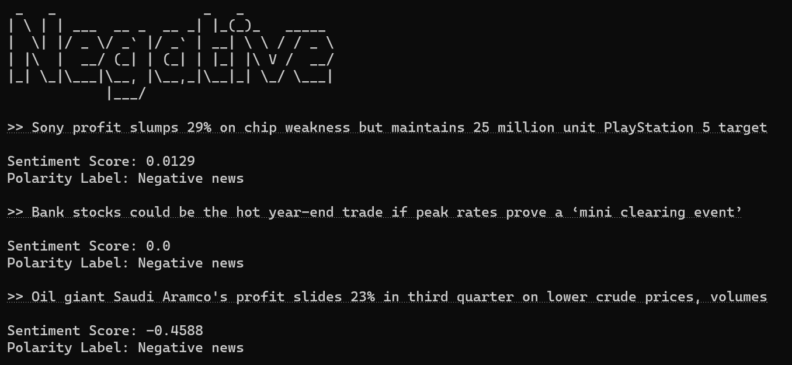
AI Chatbot - Monitoring Market Condition
SVB Overview
Issues in SVB
Liquidity and Data Analysis
Alternative Scenarios
SVB Ethical Considerations
Lessons Learnt
AI in Financial Sector
AI in Risk Management
AI Chatbot
AI Stress Testing
AI Ethical Considerations

Slide 22
AI in Stress Testing
Traditional Methods
AI
Limited set of predetermined scenarios
More expansive and plausible scenarios
Relies heavily on human judgement, leading to inaccurate parameter estimation
Improves the accuracy with which key risk parameters are estimated
Fail to capture non-linear relationships between risk factors
Able to model non-linear relationships between risk factors
Ignores the effects of sequential managerial responses
Capable of modelling path-dependent effects of actions
Labour-intensive
Can be automated
SVB Overview
Issues in SVB
Liquidity and Data Analysis
Alternative Scenarios
SVB Ethical Considerations
Lessons Learnt
AI in Financial Sector
AI in Risk Management
AI Chatbot
AI Stress Testing
AI Ethical Considerations

Slide 23
AI Ethical Considerations
AI Methods Referred to as “Black Boxes”
Removing Discrimination
US National Institute of Standards and Technology (NIST) published the “Artificial Intelligence Risk Management Framework”
Transparency: Make information about the Bank’s AI system and its output available to individuals
Explainability: Offer detailed information that will help end users understand the purposes and potential impact of an AI system
Developers should check the input for information relating sensitive information about ethical narratives through debiasing strategies or a checking mechanism
Removing Misinformation
Can be mitigated by content moderation in the training phase, while validating content accuracy through either human or machine intervention
SVB Overview
Issues in SVB
Liquidity and Data Analysis
Alternative Scenarios
SVB Ethical Considerations
Lessons Learnt
AI in Financial Sector
AI in Risk Management
AI Chatbot
AI Stress Testing
AI Ethical Considerations

Slide 24

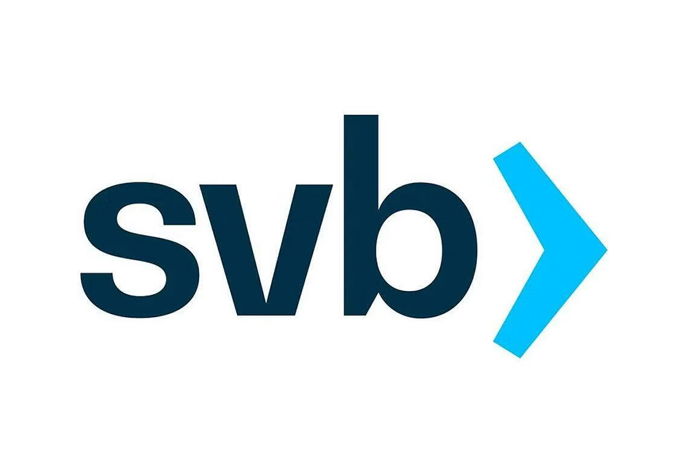
Thank you!
Any questions?

